Slide 1
Heuristic Search in Program Space for the AGINAO Cognitive Architecture
(.com)
Wojciech (Wojtek) Skaba
aginao@aginao.com

Slide 2
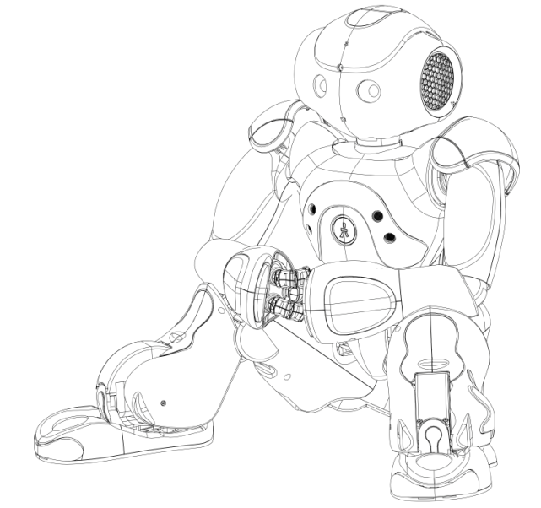
E
Sensory
Environment
Actuators
AMD GEODE 500 MHz (Linux)
Powerful host
Intel i7-980X (6 cores)
Robot
Actions
States
RL Agent

Slide 3
Robot Host communication
Sensory
raw visual data YUV422, 640x480
auditory data, FFT preprocessed (4 mikes)
joints positions
other…
up to 3 MB/sec.
Actuators
new joints positions, movements
speakers (2)
virtual fovea
other…
less than 100 kB/sec.
The RL agent has no explicit (predefined) information concerning the nature
of the sensory data, nor the actions performed by the actuators.

Slide 4
Data flow model
program code
I/O structure
type (atomic, evolved)
local static memory
priority
resources
expiration
list of actions, rewards
other
Atomic sensory
Atomic sensory
Conceptnode
Evolved node
Evolved node
Evolved node
...
Evolved node
Evolved node
Generalized artificial neuron.
Transfer function == PROGRAM
Evolved node
Evolved node
Atomic actuator

Slide 5
Self-programming == managing concept network
constructing new concepts, their structure, especially the embedded program code
adding/removing concepts to/from the concept network
adding/removing individual links between concepts
evaluating concept network
Reinforcement learning setting
STATE → „active” concept, i.e. one returning an output value (vector)
program action
ACTION → next program to be executed on that output value
action selection is independent of the current value of the output
the executed program is embedded in the next concept the selected action points to, not in the concept returning output value
for multi-input concepts (>1), execution will be postponed until all output values of the other concepts are available and valid
program action

Slide 6
Concept network evaluation
Conceptnode
long-term program code, stored on mass storage device
Runtimenode
short-term executable of a concept in RAM, lifetime <100 ms
concepts are evaluated by launching their program code as a runtime node
input/output values are runtime specific, i.e. unique for different runtimes
multiple runtimes of the same concept (>1000) may coexist and be executed
terminated runtimes cause updates of RL value functions, links and concept nodes
Conceptnode
Runtimenode
Runtimenode
Conceptnode
Runtimenode

Slide 7
Hermeneutic circle*
Remove concept
Discard runtime, if execution has failed
Terminated runtime
Execute runtime
Update RL values Remove links
Conceptnode
New created runtime
Terminated runtime
Repeat N times
Ask for next action
Create new runtime
Add new concepts
Add new links
Conceptnode
Terminated runtime
Conceptnode

Slide 8
System design layers
Virtual Machine
One accumulator (int), one IDX register (int), ZERO flag, MINUS flag, local static memory (int *), one output (int *), N>0 inputs (int *), now int == 16 bits.
PHYSICS
VM Instruction Set
50+ machine code instructions, fixed but customizable, resembling those of early 1980s microprocessors, plus special purpose instructions, like WAIT.
ELEMENTS
Concept Programs
Program Generator makes short programs, 4-7 instructions long. A heuristic search, applying 30+ rules, reduces the space of 10²⁰ programs to ˜ 10⁸ useful ones.
CHEMISTRY
Executable runtimes
Sorting out useless concept/links continues for programs: reporting fatal errors (e.g. out of range), running out of resources (infinite loop), correct but rarely utilized, useless in terms of RL, those that just didn’t have luck.
LIFE

Slide 9
Internal program/data structure
All concept share and exchange data with the same common type int[n], i.e. a vector (array) of n integers. The int → int16_t (16-bit) in current implementation.
0 1 2 3 4 5
Example: single visual pixel
5
row
col
Y
U
V
12 bytes
size coordinates value
int *prog(const int *src_1,..., const int *src_N) { static int memory[size];
// program code here
}
Each program consists of:
N>0 const input vectors that (cannot be overwritten), length known at runtime
single output vector, predefined max length, actual length is returned
optional local static memory, know size, shared among all runtimes

Slide 10
VM Diagram
acc
idx
Input(s)
int
int
Z
M
Output
size
int
int
int
CPU
size
int
int
int
size
int
int
int
int
int
int
local static
0000 MOVI IDX, 0002
0003 MOVX A, var1[idx]
0006 SAVI [00],A
0009 RET
0000 MOV A, var1[00]
0005 ADD A, var2[00]
0010 APPEND, A
0011 JZ 0005
0014 RET

Slide 11
Noteworthy controls of runtimes
Expiration time – a real time value of milisecond resolution, typically 100 ms since the runtime creation time. When time passes, the runtime passes away, no matter what state it is currently in.
Priority – individually assigned real number determining the order of execution relative to other runtimes currently awaiting in the priority queue.
Resources – individually assigned real number determining the amount of system resources a runtime may exhaust. Basically, it denotes the number of VM instructions a runtime may perform. Useful for overcoming the halting problem.
Status – the state a runtime is in: PENDING, CREATED, EXECUTED, SLEEP, TERMINATED, EXITED, DISCARD (discussed below).
Hash – calculated based on a unique ID of a concept to launch its runtime and IDs of runtime(s) of all input(s), used to avoid repeated computation of the same combination of data and program.

Slide 12
Runtime life cycle and state transitions*
Pending
A runtime is requested but awaiting all inputs to be available. This is the case of multiple input concepts only. 70% runtimes do timeout before completion.
Created
Ready to run and awaiting in a priority queue. 50% timeout before having ever a chance to be executed. Single input concepts start in this state directly.
Executed
Will return success or error. Context switching may put the runtime in priority queue again.
Sleep
If a temporal instruction is encountered, execution is suspended until rise time passes.
Terminated
The program completed computation and returned output vector. This thread is supposed to breed more processing.
Exited
The program completed computation w/o any error, but exited due e.g. not finding a match. Further processing for this thread is aborted.
Discard
The program reported a fatal error or exhausted all resources. Actual memory releasing is posponed until all dependent processes unlock the runtime.

Slide 13
Natural environment parallel
Concepts
Species
Runtimes
Individuals of species
Links
Dependencies between species
Non-parallels
Concepts do not evolve, i.e. program code doesn’t chage during concept lifetime.
A species (concept) may exist even if currently no single individual (runtime) is living.
Concept program code and structure is reusable. Two separate concepts placed at different location of the network may share exactly the same „genotype”.

Slide 14
Processing temporal patterns*
Special purpose instructions
WAIT
suspend execution for N miliseconds
DELAY
compute difference (ms) between the creation time of the executed runtime and the creation time of one of the inputs
Application example
Visual movement detecting concept
pixel 1, pos. x₁,y₁
Pseudocode
DELAY pixel 1
DELAY pixel 2
DELAY pixel 3
check condition
TERMINATE if fulfilled
EXIT otherwise
pixel 2, pos. x₂,y₂
match
pixel 3, pos. x₃,y₃

Slide 15
Vision Processing example
New image arrives from robot to host
New image is compared with the currently stored
If pixel difference in YUV exceeds a predefined threshold, a vector is created.
5
row
col
Y
U
V
An atomic sensory runtime is created, directly in TERMINATED state, with pixel vector as output value.
Runtimenode
int
int
int
int
int
int
Runtimenode
Runtimenode
Runtimenode
Runtime a priori priority is set to amplitude in luminance .
Runtimenode
Runtime
is placed in a priority queue.
Runtimenode
Runtimenode
Priority = abs(Y_{t1}-Y_{t0})

Slide 16
Concept integration & pattern matching*
1
2
2
3
2
2
Runtimenode
4
Concept node
Runtimenode
Runtimenode
Concept node
Runtimenode

Slide 17
Exploration/Exploitation & Intrinsic motivation
Concept node
Exploration → adding new action (link and concept)
R_{const} R_{const}+∑R_{i}
P(Exploration) ~
Concept node
Temporal difference learning
No distinct consecutive states → learning may be performed concurrently
Immediate reward

Slide 18
Immediate reward as intrinsic reward
rewarding concept
independently calculated for each link/action
immediate reward
non-rewarding concept
justified by cumulative reward
state space
...
JMP COND
EXIT (negative)
RET (positive)
Concept node
p = ( )
N_{pos} N_{pos}+N_{neg}
partitioning
r = - log₂(p)
r_{avg.} = - p*log₂(p)

Slide 19
Comparison with other approaches
Levin Search and similar attempts (naïve approach)
intractable, limited distinction between data and program, no continuous operation, etc.
OOPS (Schmidhuber) incremental learning: requires list of problems. AGINAO approaches problems in natural order of their complexity. PUnS (Schaul,Sch.), Frontier Search (Sun,Sch.), Self-improving program search (Kaiser).
Gödel machine (Schmidhuber) the other extreme. Is AGINAO an approximation?
Evolutionary/Genetic programming
AGINAO does not match definition: no fitness function, no population, no generations/mutations, etc. Extensions: ADF, reusable programs (Koza).
Evolutionary methods not applicable for interaction with the environment (Sutton).
Self-programming for the AGI – disctinction from adaptivity/learning
must have a Turing-like machine built-in on top, or its source code be modifiable
programs must be automatically/random generated rather than human crafted
do not match criteria: LIDA (Franklin), HTM (Hawkins), NARS? (Wang), Soar (Laird)
match: Novamente (Goertzel), MOSES, automated program learning (Looks), VARIAC (Hall), Ikon Flux (Nivel,Thorisson)

Slide 20
Summary: unique properties of AGINAO architecture
Robotic/Embodied approach in natural environment that constitutes optimally ordered training examples. No dealing with toy problems.
Temporal aspect of the concepts naturally embedded in the cognitive architecture. Spatial and temporal patterns are virtually indistinguishable by the learning engine.
Built-in processes of artificial economics, to cope with the danger of combinatorial explosion, to list: priority queue, expiration time, resource management.
Two step self-programming: at the machine code level and at the concept level, for greater flexibility.
No explicit fitness measure. The learning is supposed to be based purely on the information theory. Instead of trying to learn how to solve a given problem the system solves what can easily be learned. Only on the foundation of easily learned concepts it would proceed to the more challenging ones, eventually to encounter and attack the problems the designers would like it to solve.

